Slide 1

AI-ROI-Chat
Created by Carlos Eli Escobar Ruiz and Jorge Fernando Palacios de los Santos.

Slide 2
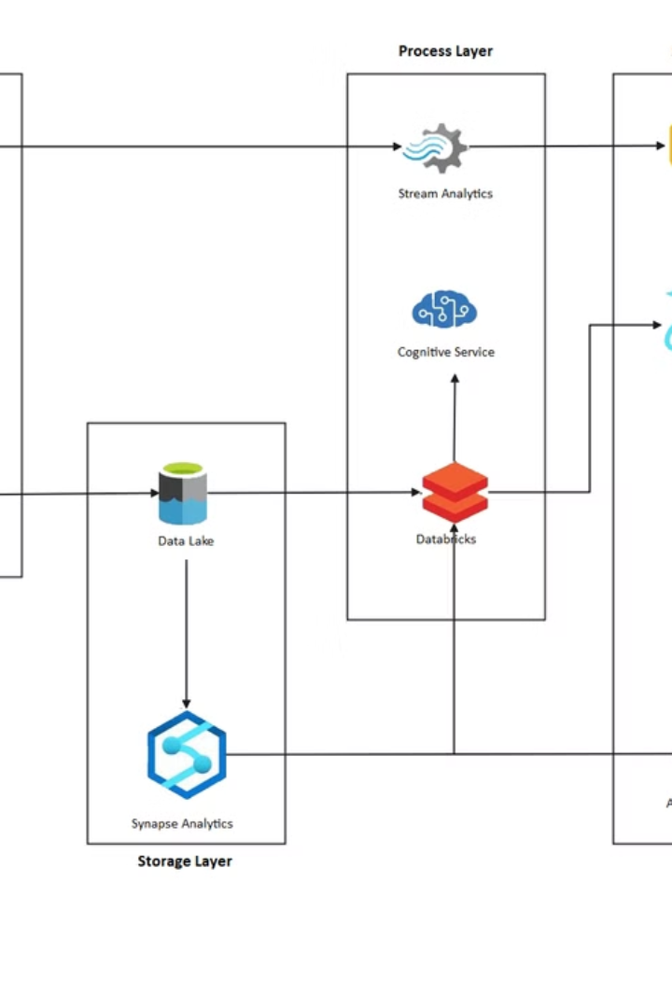



Technology Stack
Laravel
Microsoft
Azure AI
Robust PHP framework for building secure, scalable web applications.
Enterprise-grade cloud infrastructure with global reliability.
Advanced AI services including OpenAI and Speech-to-Text capabilities.

Slide 3
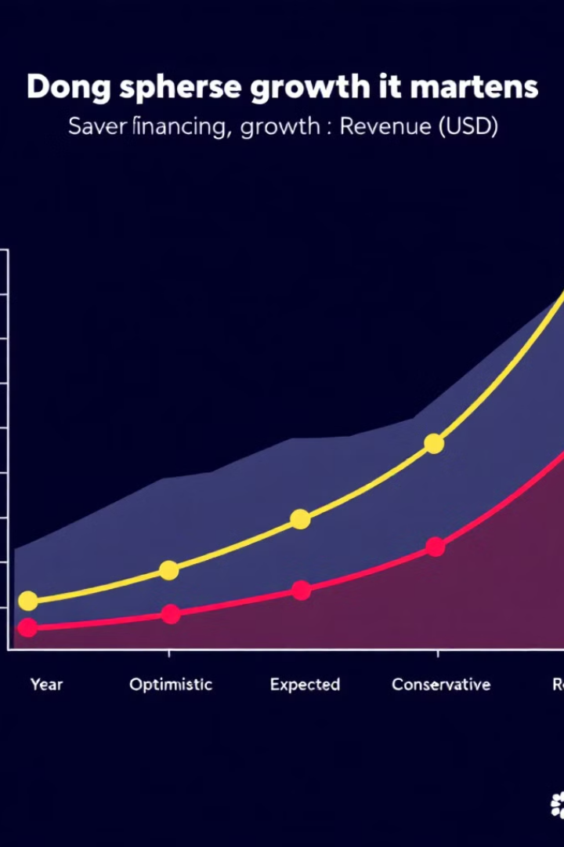
Investment Return Scenarios
Investment Type
Best Case
Neutral Case
Worst Case
Physical Investment
2 years
3 years
5 years
Digital Investment
2 years
3 years
5 years
Investment Funds
2 years
3 years
5 years

Slide 4
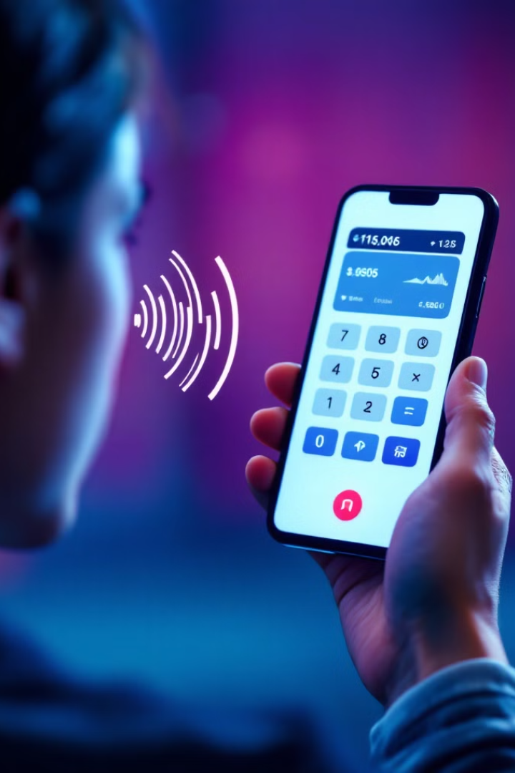



Custom ROI Calculator
Tailored Analysis
Voice Interaction
Trained specifically for investment return calculations across multiple scenarios.
Unique text and voice input capabilities set it apart from market alternatives.
Unlimited Usage
Create infinite individual exercises for various investment scenarios.
Try it now: https://roi.wbor.dev/login

Slide 5




User-Friendly Experience
Multilingual
Step-by-Step
Versatile
Responds in your preferred language throughout the entire interaction.
Guides you through information input with helpful tips.
Works for digital businesses, physical companies, savings, and human capital.

Slide 6






Detailed Results
Recalculate
Reopen chats to modify information and update scenarios.
Visual Reports
Comprehensive graphs and metrics for all scenarios.
Unlimited Revisions
Use this feature as many times as needed.

Slide 7



Application Interface
Mobile Experience
Desktop Dashboard
Voice Interaction
Access your ROI calculations on the go with our responsive design.
View comprehensive analytics and reports on larger screens.
Simply speak your inputs for a hands-free experience.

Slide 8






Use Cases
Optimal Results
Make informed decisions with confidence.
Multiple Stakeholders
Share insights with team members and investors.
Various Scenarios
Test different investment approaches before committing.

Slide 9
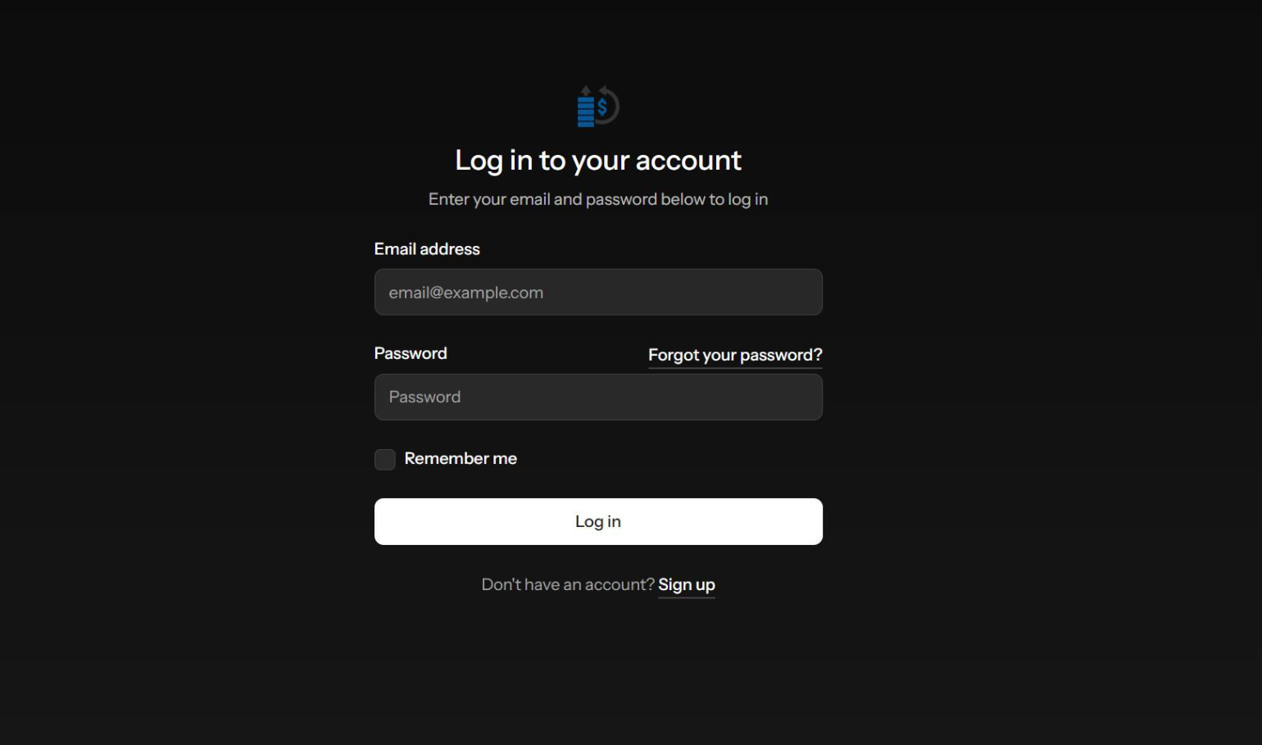

Slide 10
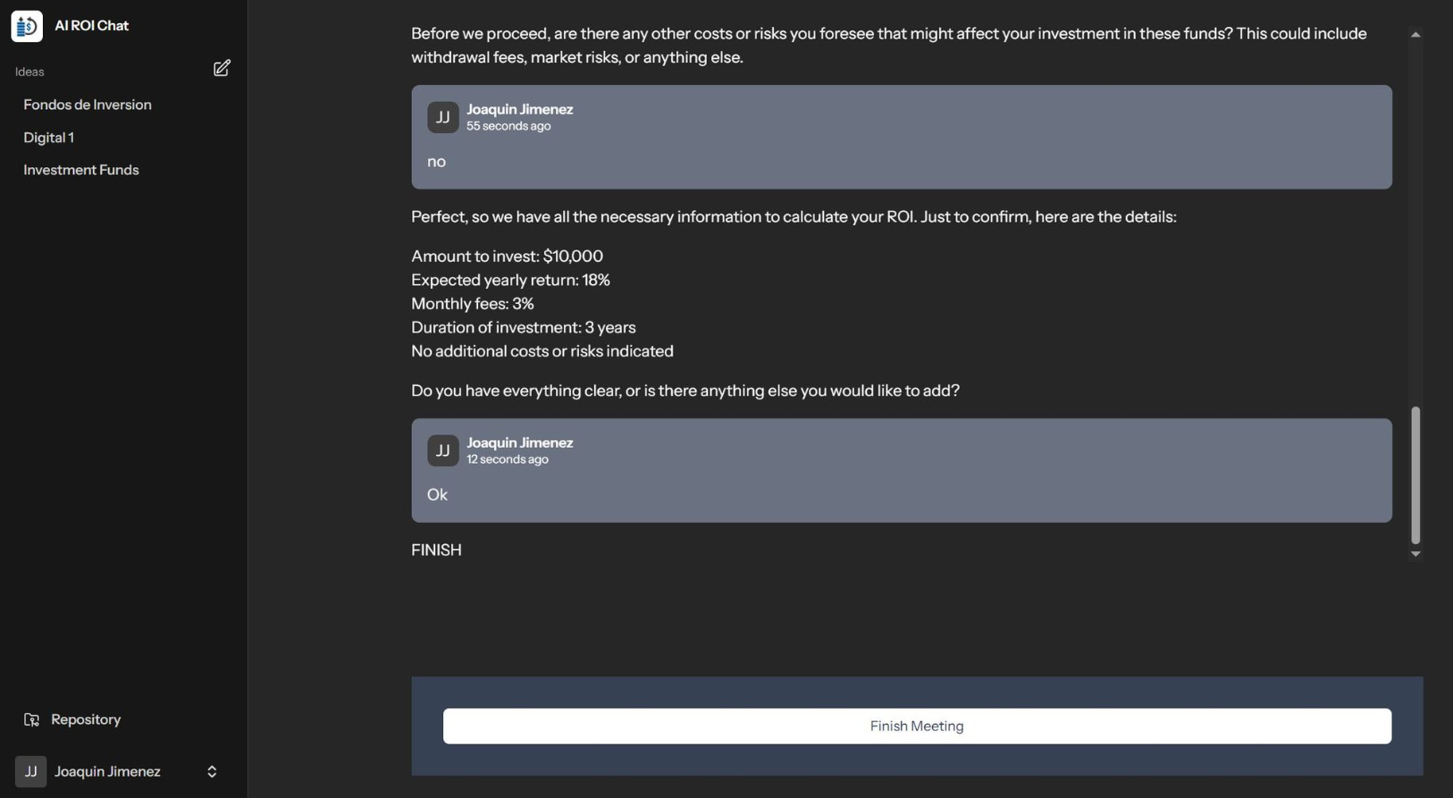

Slide 11
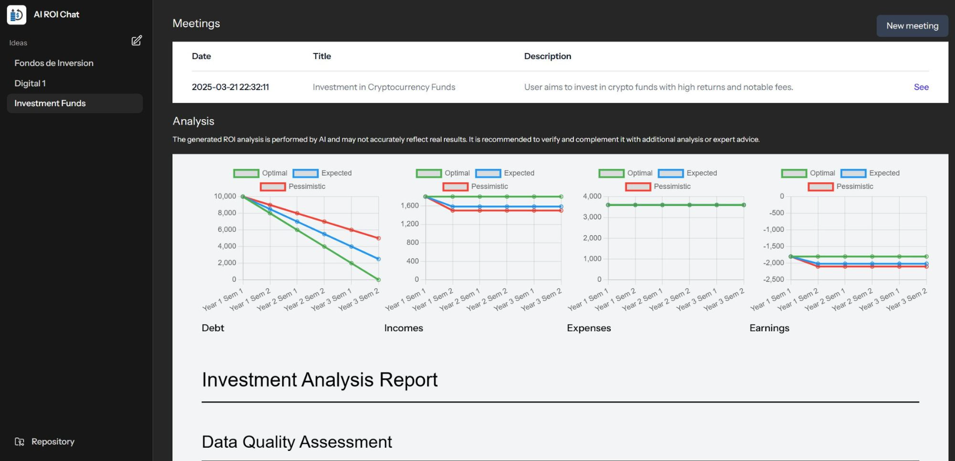

Slide 12

Disclaimer
AI-Generated Content
Limitations
We use AI to optimize efficiency and provide valuable information.
Results may not reflect the experience or opinions of individuals.
Recommendation
Consult with a specialist for more specific results.

